Slide 1

A
PROJECT REPORT
On
KEYLOGGER
SUBMITTED BY :
AJEYPALSINH JADEJA (Eno:-20082291039)
RIYAKUMARI PATEL (Eno:-20082291017)
B.Sc.IT (Cyber Security) Semester-v
Group No – 01
Guided By :
Internal : Prof. Deepika Patel

Slide 2
CONTENTS
Sr. No. | Particulars
1 | Project Profile
2 | Introduction
 | 2.1 Overview
 | 2.2 Background and Motivation
 | 2.3 Objective
 | 2.4 Methodology
3 | Hardware and Software Requirement
4 | Tools Description
5 | Functional Specification
6 | Proof Of Concept
7 | Future Scope
8 | References

Slide 3
PROJECT PROFILE
Project Title :- | KEYLOGGER
Objective :- | Keylogger :- For Tracking Someone In Ethical Way
Operating System :- | Windows , Linux
Platform :- | Vs code
perform By :- | Ajaypalsinh jadeja (E.NO :- 20082291039) Riyakumari patel (E.NO :- 20082291017)
Internal guide :- | Prof. Deepika Patel
Group no :- | 01

Slide 4
INTRODUCTION
Keyloggers are a particularly insidious type of spyware that can record and steal consecutive keystrokes (and much more) that the user enters on a device.
Computer monitoring software works in invisible mode and does not appear on the Desktop, Add/Remove Programs, Control panel and even hidden in installation path folders.
Keyloggers software provides facility to send details of recorded activities at user specified email address.

Slide 5
Two types of keyloggers :-
1) Hardware keylogger
2) Software keylogger

Slide 6
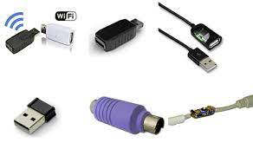
1. Hardware keylogger:-
A hardware-based keylogger is a small device that serves as a connector between the keyboard and the computer.
The device is designed to resemble an ordinary keyboard PS/2 connector, part of the computer cabling or a USB adaptor, making it relatively easy for someone who wants to monitor a user's behavior to hide the device.

Slide 7
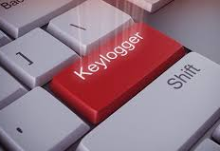
2. Software Keylogger :-
A keylogging software program does not require physical access to the user's computer for installation.
It can be purposefully downloaded by someone who wants to monitor activity on a particular computer, or it can be malware downloaded unwittingly and executed as part of a rootkit or remote administration Trojan (RAT).
The rootkit can launch and operate stealthily to evade manual detection or antivirus scans.

Slide 8
2.1 OVERVIEW
Keyloggers operate in the context of malware, they are not always illegal to install and use.
Keyloggers are a common tool for corporations, which information technology departments use to troubleshoot technical problems on their systems and networks—or to keep an eye on employees surreptitiously.
The term keylogger, or "keystroke logger," is self-explanatory: Software that logs what you type on your keyboard.

Slide 9
2.2 BACKGROUND and MOTIVATION
A keyloggers are a form of spyware where users are unaware their actions are being tracked.
A keylogger is a form of malware or hardware that keeps track of and records your keystrokes as you type.
It takes the information and sends it to a hacker using a command-and-control (C&C) server.

Slide 10
2.3 OBJECTIVE
The objective of keyloggers is to interface in the chain of events that happen when a key is pressed and when the data is displayed on the monitor as a result of a keystroke.

Slide 11
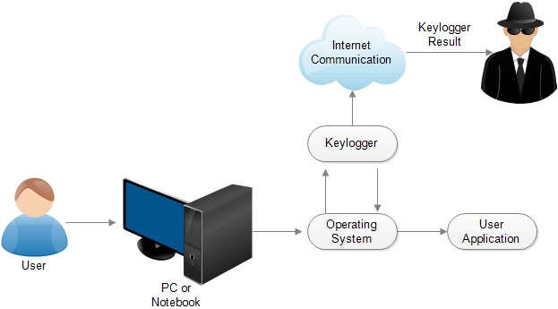
2.4 METHODOLOGY

Slide 12
Hardware Requirement
Processor | 2 GHz or above
RAM | Minimum 4 GB
Storage Free Space | 20 GB or More

Slide 13
Software Requirement
Operating System | Windows , Linux
Platform | Vs code

Slide 14
Platform description
Visual Studio Code, also commonly referred to as VS Code, is a source-code editor made by Microsoft with the Electron Framework, for Windows, Linux and macOS.
Features include support for debugging, syntax highlighting, intelligent code completion, snippets, code refactoring, and embedded Git.
Users can change the theme, keyboard shortcuts, preferences, and install extensions that add additional functionality.

Slide 15
LIBRARIES (MODULES) :-
KEYBOARD :-
It is used to get full control of the keyboard.
It is a small python library which can hook global events, register hotkeys, simulate key presses and much more.
It helps to enter keys, record the keyboard activities and block the keys until a specified key is entered and simulate the keys.
It captures all keys, even onscreen keyboard events are also captured.
Keyboard module supports complex hotkeys. Using this module we can listen and send keyboard events.

Slide 16
SMTPLIB :-
Simple mail transfer protocol (SMTP) is protocol, which handles sending e-mail and routing e-mail between mail servers.
Python provides a smtplib module, which defines an the SMTP client session object used to send emails to an internet machine.
For this purpose, we have to import the smtplib module using the import statement.

Slide 17
MIMEMULTIPART :-
Multipurpose Internet Mail Extensions (MIME) is an internet standard that is used to support the transfer of single or multiple text and non-text attachments.
MIMETEXT :-
MIMEText is for text (e.g. text/plain or text/html), if the whole message is in text format, or if a part of it is.

Slide 18
IO :-
This module is a part of the standard library, so there’s no need to install it separately using pip.
We can handle the file-related input and output processes with the help of the python IO module.
The python standard library comes with this module.
The advantage of using the IO module is that the classes and functions available allows us to extend the functionality to enable writing to the Unicode data.

Slide 19
SOUNDDEVICE :-
Sounddevice provides bindings for the PortAudio library and convenience functions to play and record NumPy arrays containing audio signals.
In order to play WAV files, NumPy and Soundfile need to be installed , to open WAV file as NumPy arrays

Slide 20
SCIPY :-
SciPy stands for Scientific Python.
SciPy is a scientific computation library that uses NumPy.
It provides more utility functions for optimization, state and single processing.
Like NumPy, SciPy is open source so we can use it freely.

Slide 21
WAVFILE :-
The wave module in python’s standard library is an easy interface to the audio WAV format.
The functions in this module can write audio data in raw format to a file like object and read the attributes of a WAV file.
This file is opened in write or read mode just as with built-in open() function, but with open() function in wave module.
WAV or Waveform is an audio file standard for storing digital audio on PC.

Slide 22
Functional specification
Keylogger is going to be written in Python programming language.
It will be functioning in Windows environment.
Key logger will run in stealth mode.
It will start to run whenever operating system starts to run.

Slide 23
Proof Of Concepts

Slide 24
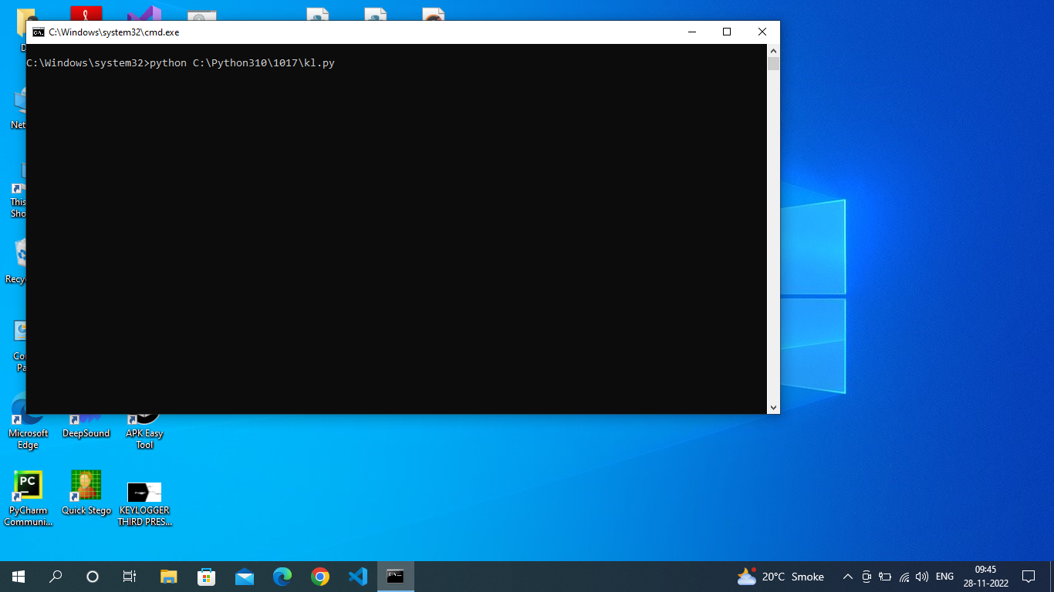
Automatically Send The Mail When Start The PC.

Slide 25
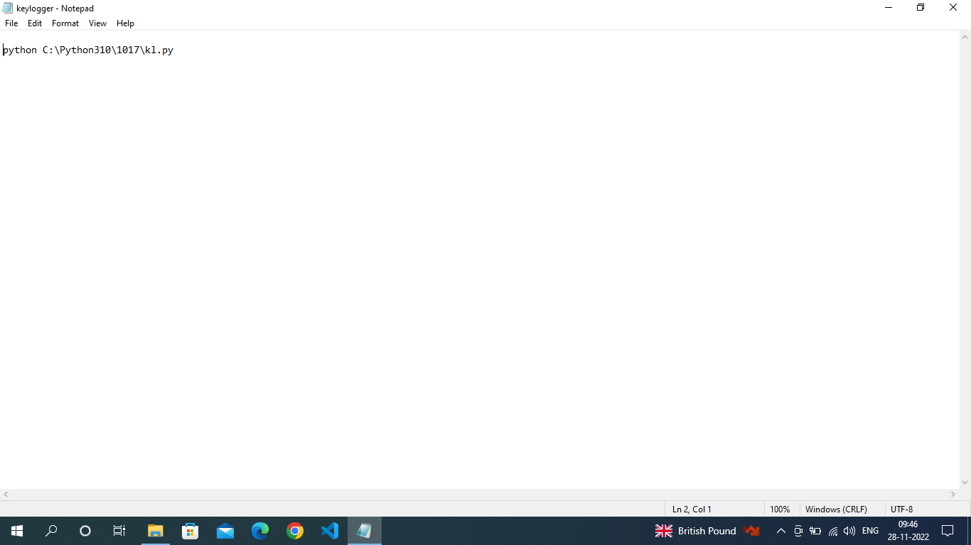

Slide 26
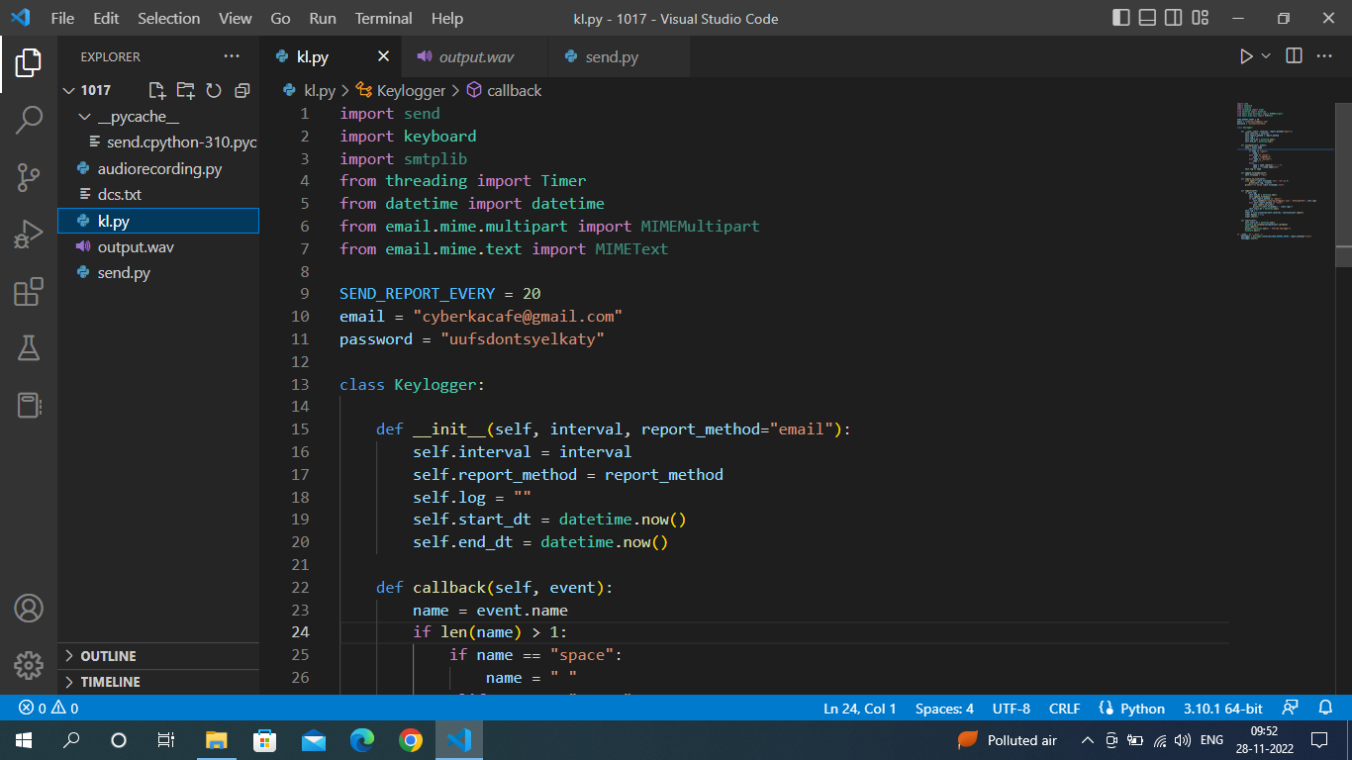

Slide 27
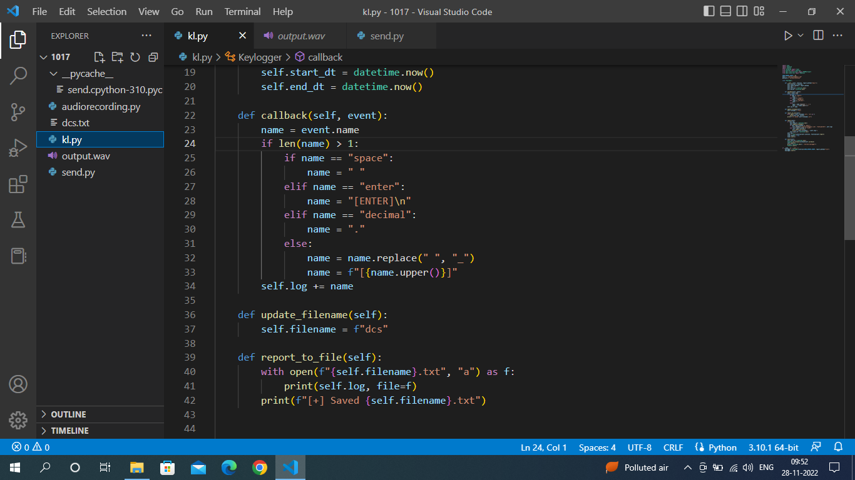

Slide 28
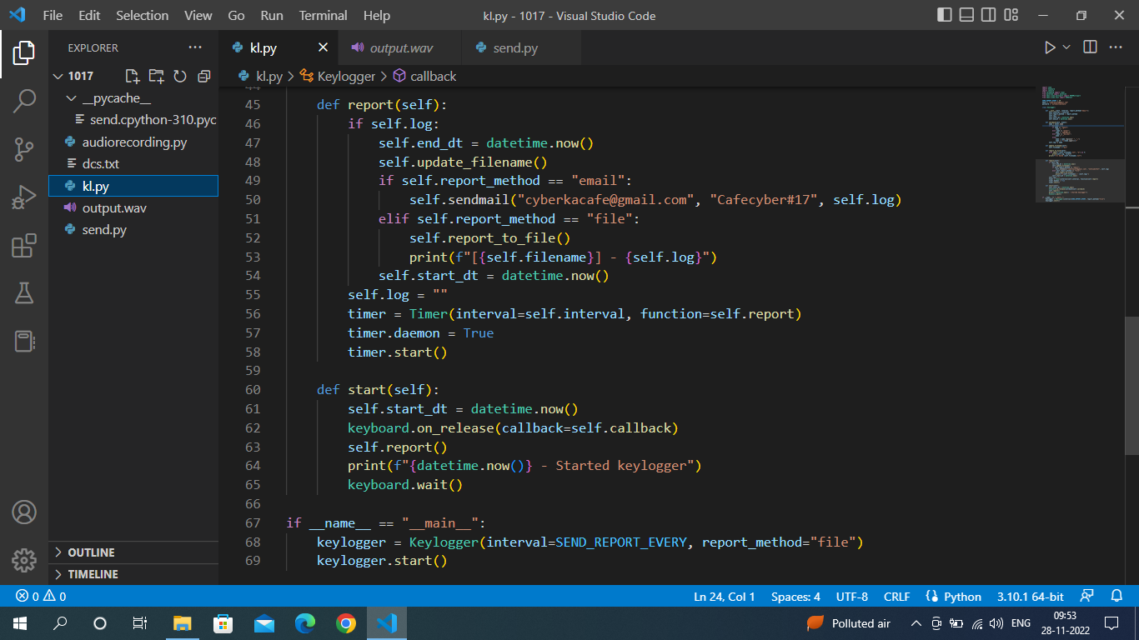

Slide 29
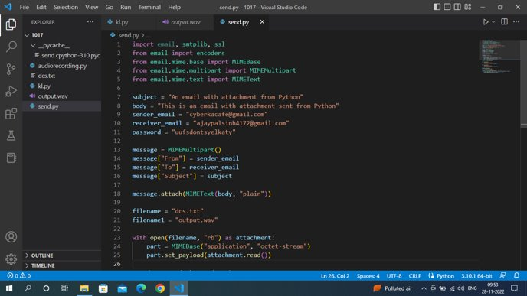
Email Code :-

Slide 30
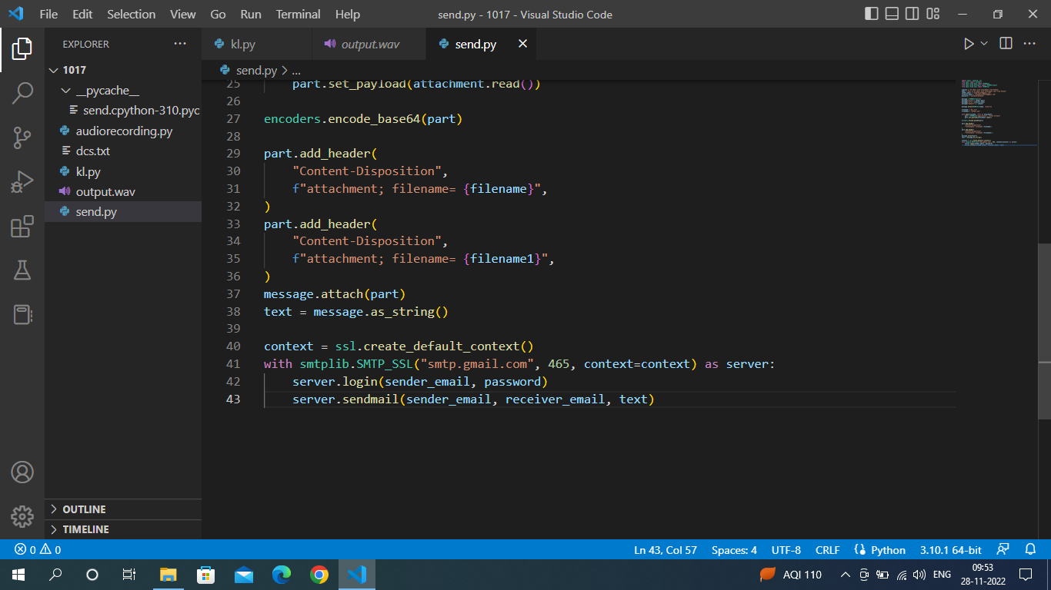

Slide 31
Audio Recording :-
Audio recording is the process by which sound information is captured onto a storage medium like magnetic tape, optical disc, or solid-state drive (SSD).
The captured information, also known as audio, can be used to reproduce the original sound if it is fed through a playback machine and loudspeaker system.
here we are using wav file.
WAV or Waveform Audio File Format was developed jointly by Microsoft and IBM as an audio file standard for storing digital audio on PC.
This format originated based on the Resource Interchange File Format (RIFF), a bitstream format that stores audio data in 'chunks'.

Slide 32
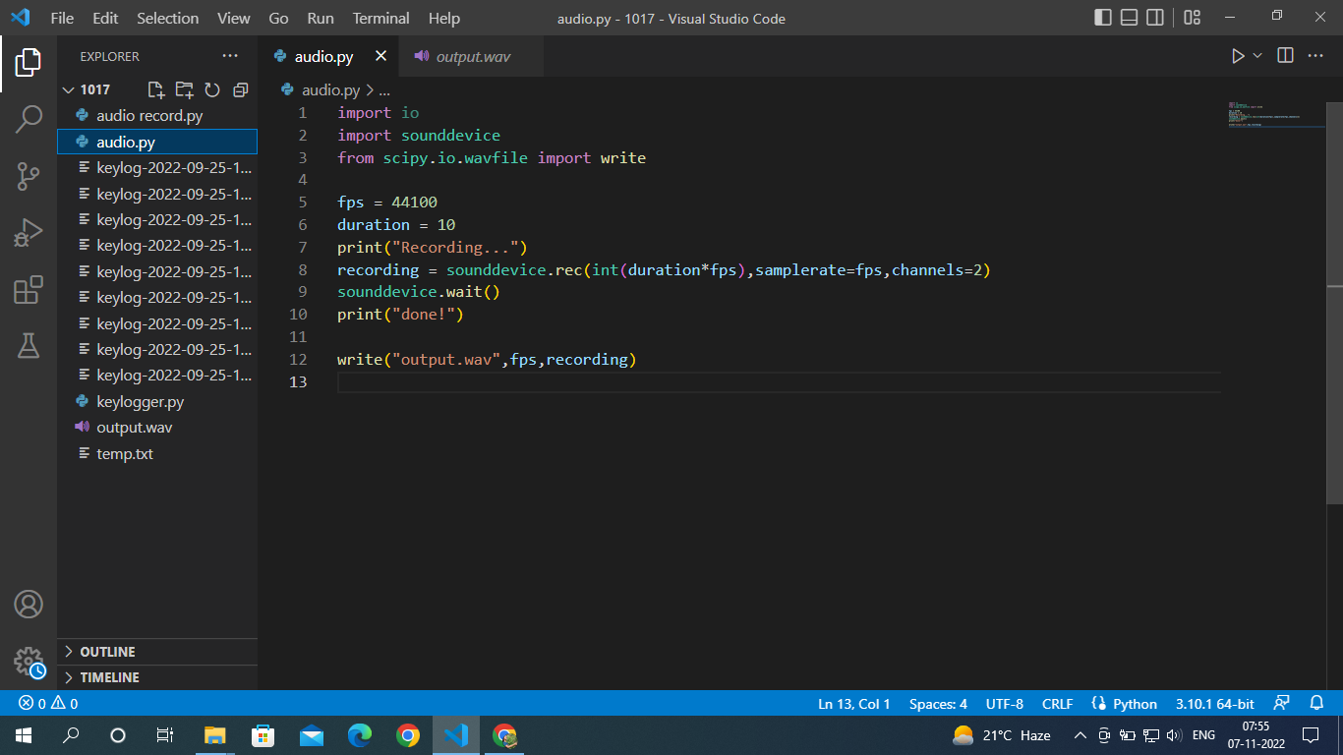

Slide 33
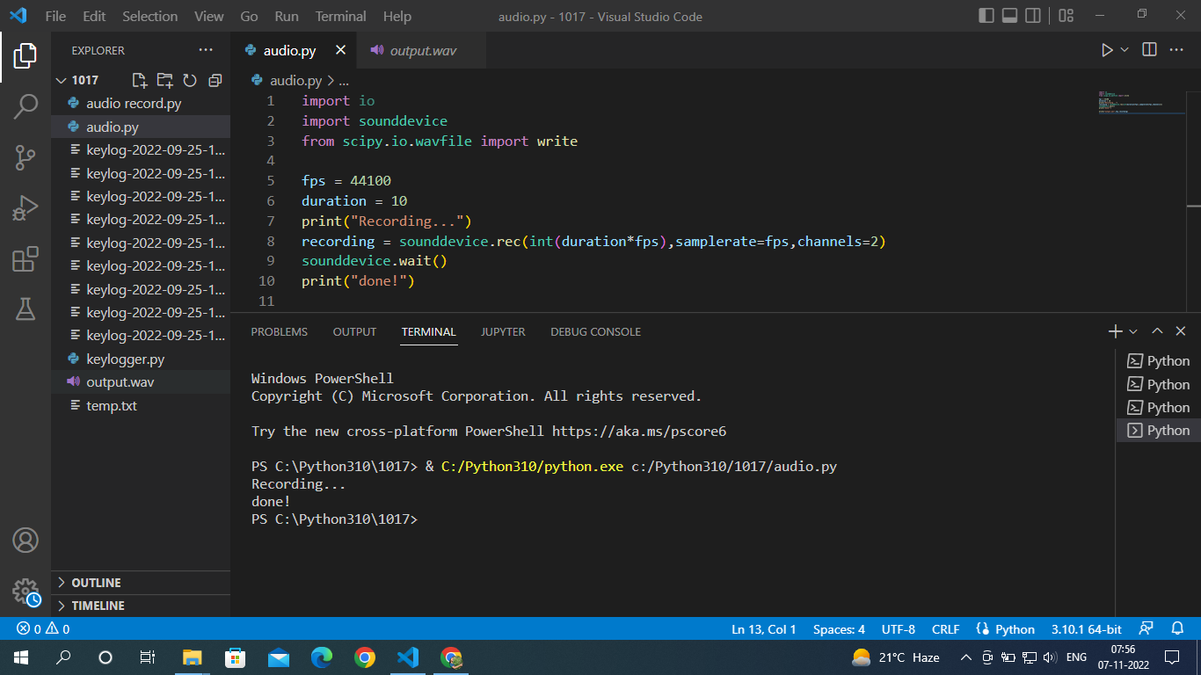

Slide 34
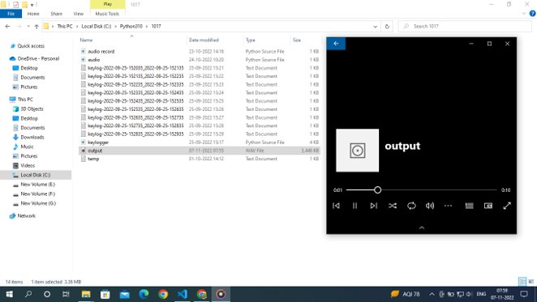
OUTPUT RESULT

Slide 35
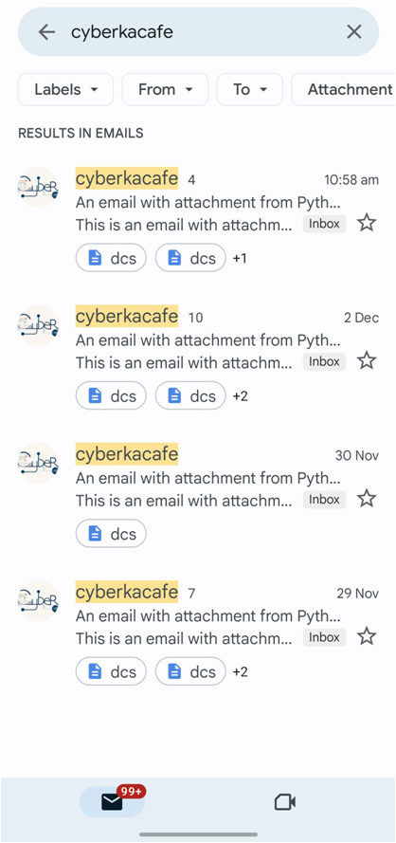
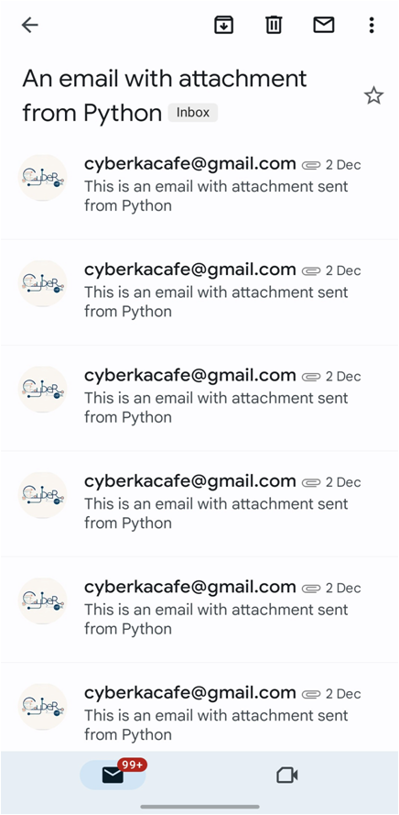
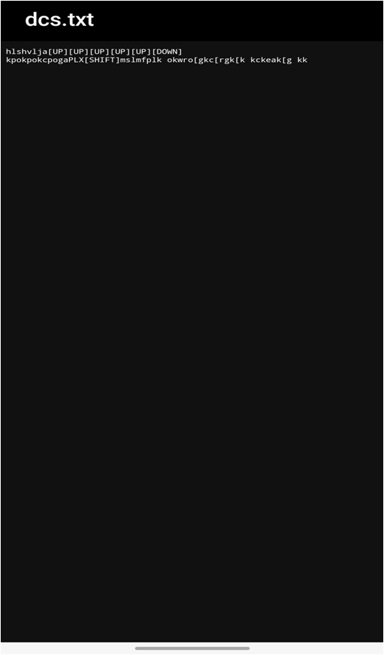

Slide 36
FUTURE SCOPE
It also used for parents to monitoring the children’s activity.
This technique requires much more calculation to be doe and also the false positive rate is very high.
This technique has the ability to artificially inject carefully crafted keystroke patterns, and discussed the problem of choosing the best input pattern to improve our detection rate with no false positives and no false negatives reported.
As a result of this technique, the malicious activities can be known in advance and controlled

Slide 37
References :
www.google.com
https://www.techtarget.com
https://www.w3school.com
https://www.geeksforgeeks.org
https://www.kaspersky.com.in
https://www.veracode.com

Slide 38
Thank you

